Slide 1
Character and Reader/Writer/Files
Part 2
Chapter-06
Rima Patel

Slide 2
Files and Exceptions
When creating files and performing I/O operations on them, the systems generates errors. The basic I/O related exception classes are given below:
  EOFException – signals that end of the file is reached unexpectedly during input.
  FileNotFoundException – file could not be opened
  InterruptedIOException – I/O operations have been interrupted
  IOException – signals that I/O exception of some sort has occurred – very general I/O exception

Slide 3
Syntax
Each I/O statement or a group of I/O statements must have an exception handler around it/them as follows:
  try {
  …// I/O statements – open file, read, etc.
  }
  catch(IOException e) // or specific type exception
  {
    …//message output statements
  }

Slide 4
Example
import java.io.*;
class CountBytesNew {
public static void main (String[] args)
throws FileNotFoundException, IOException
{
FileInputStream in;
try{
in = new FileInputStream("FileIn.txt");
int total = 0;
while (in.read() != -1)
total++;
System.out.println("Total = " + total);
}
catch(FileNotFoundException e1)
{
System.out.println("FileIn.txt does not exist!");
}
catch(IOException e2)
{
System.out.println("Error occured while read file FileIn.txt");
}
}}

Slide 5
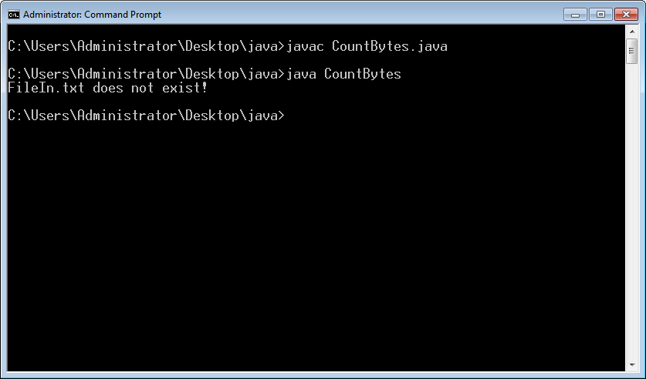

Slide 6
Java File Class
Java File class is a part of java.io package.
Java File class is an abstract representation of file and directory pathnames.

Slide 7
File Constructors
Constructor | Description
File(File parent, String child) | It creates a new File instance from a parent abstract pathname and a child pathname string.
File(String pathname) | It creates a new File instance by converting the given pathname string into an abstract pathname.
File(String parent, String child) | It creates a new File instance from a parent pathname string and a child pathname string.
File(URI uri) | It creates a new File instance by converting the given file: URI into an abstract pathname.

Slide 8
Example
import java.io.*;
public class FileExample1
{
public static void main(String args[]) throws IOException
{
File fobj=new File("D:/RP/fileexample1.txt");
fobj.createNewFile();
File fobj1=new File("./fileexample1.txt");
fobj1.createNewFile();
}
}

Slide 9
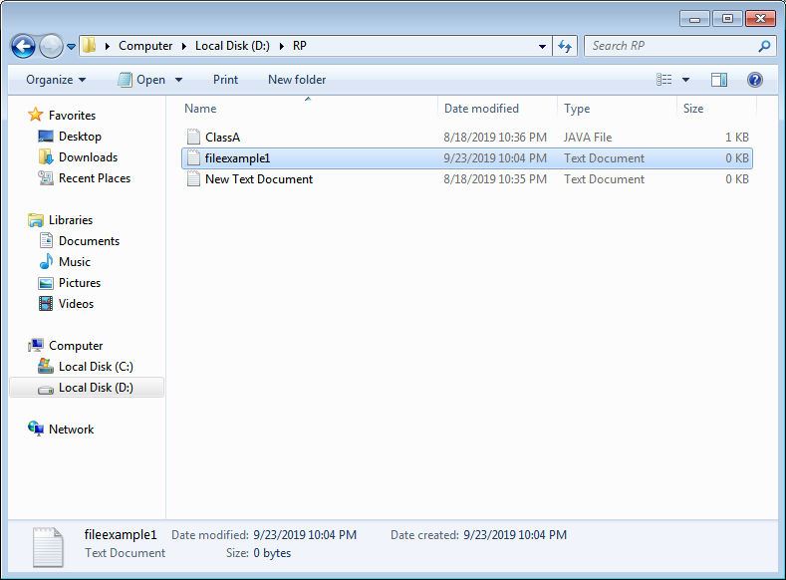

Slide 10
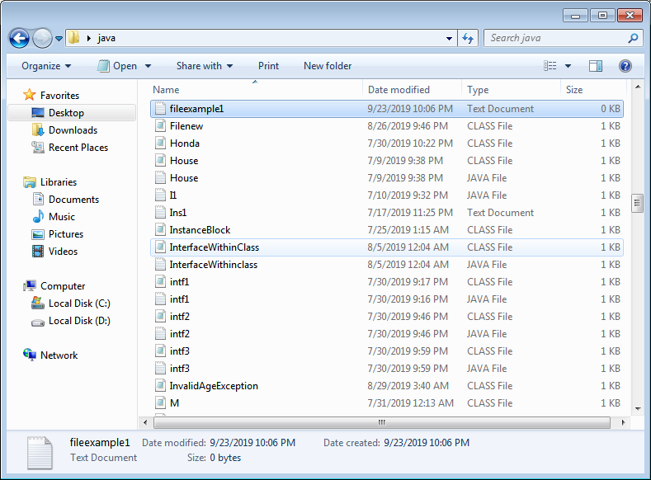

Slide 11
Example
import java.io.*;
public class FileExample2
{
public static void main(String args[]) throws IOException
{
File fobj=new File("D:/RP/fileexample1.txt");
fobj.createNewFile();
System.out.println(fobj.exists()+" : fileexample1");
System.out.println(fobj.length()+" :size of fileexample1");
}
}

Slide 12
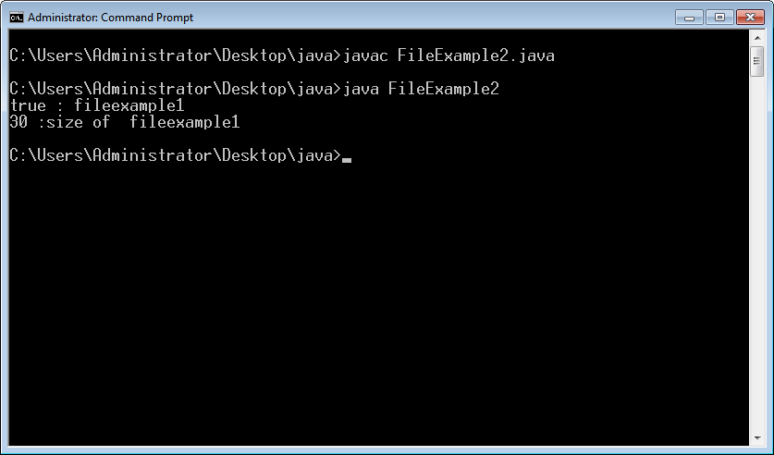

Slide 13
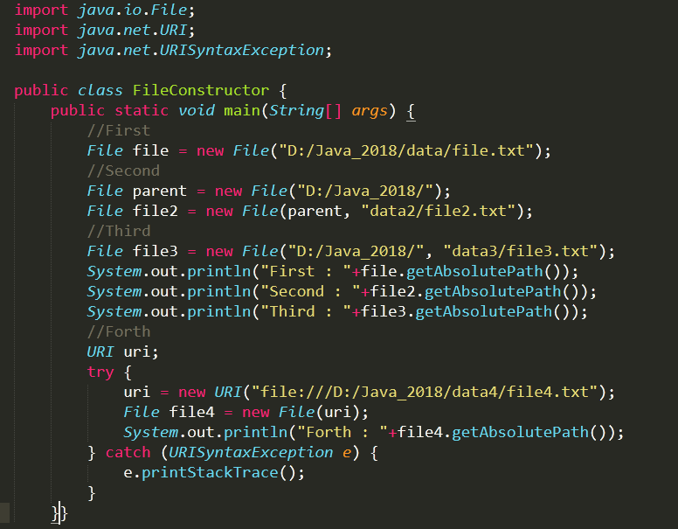
Example

Slide 14
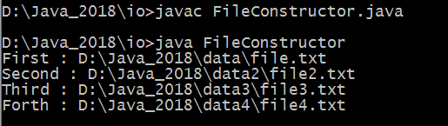
Output

Slide 15
File Class Useful Methods
30+ methods

Slide 16
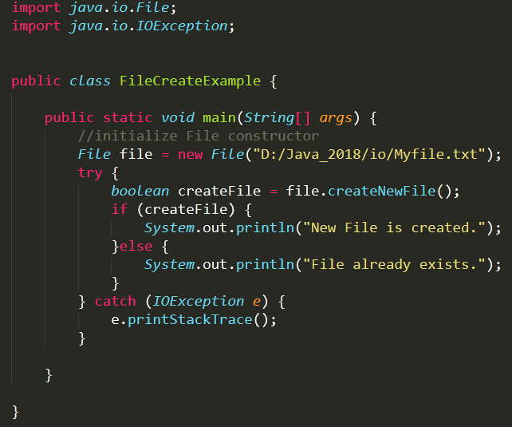
Create New File

Slide 17
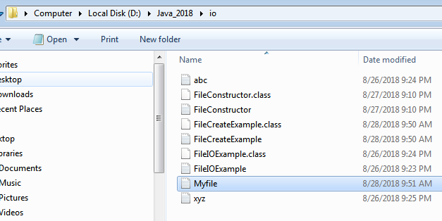
Output

Slide 18
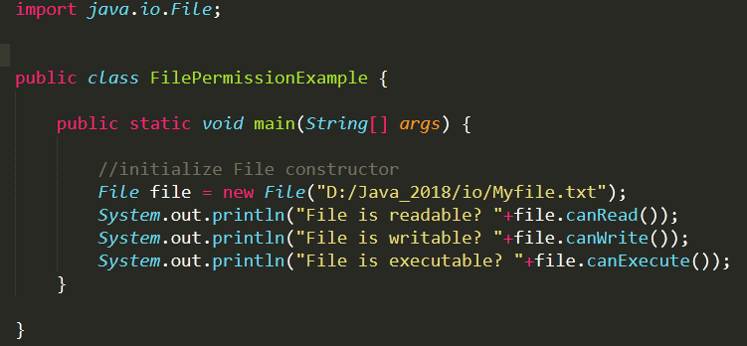
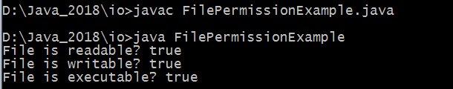
Check File Permissions

Slide 19
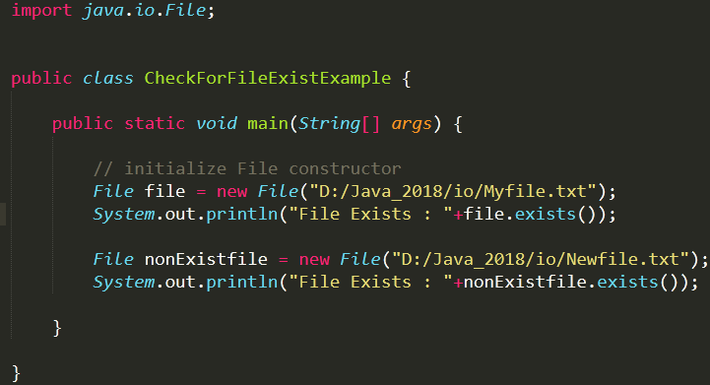
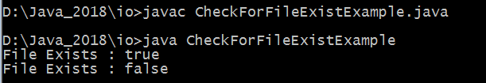
Check if File already exists?

Slide 20
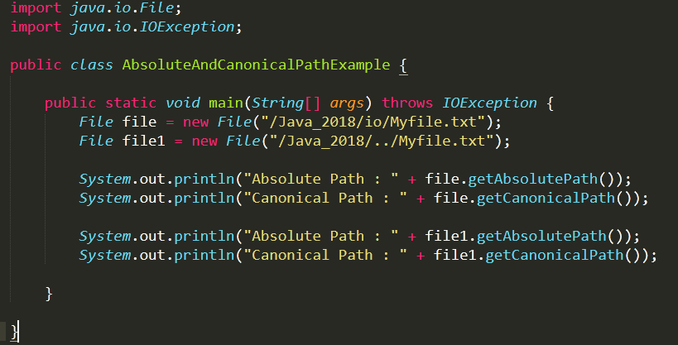
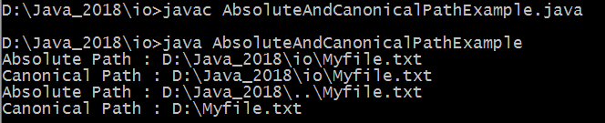
Java File Absolute & Canonical Path

Slide 21
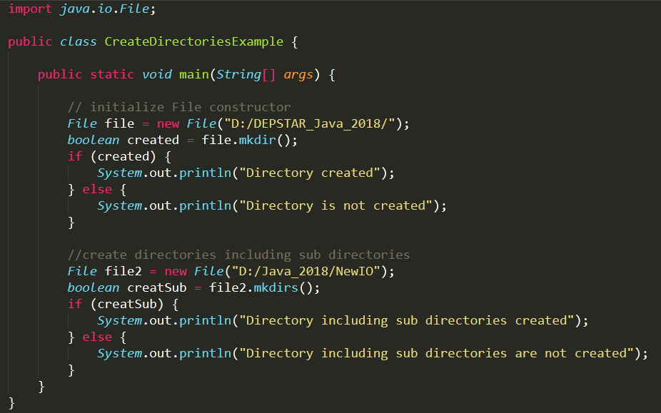
Create Directories

Slide 22
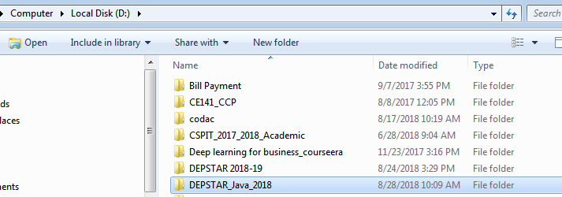
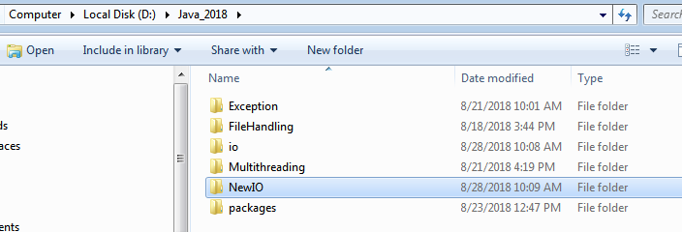
Output

Slide 23
Reading and Writing Characters
As pointed out earlier, subclasses of Reader and Writer implement streams that can handle characters.
The two subclasses used for handling characters in file are:
  FileReader
  FileWriter
While opening a file, we can pass either file name or File object during the creation of objects of the above classes.

Slide 24
Reader Class Hierarchy
Reader
StringReader
CharacterArrayReader
PipedReader
BufferedReader
FileInputStream
InputStreamReader
FileterReader
FileReader
PushbackReader

Slide 25
Reader - operations
public int read() | Reads a character and returns as a integer 0-255
public int read(char[] buf, int offset, int count) | Reads and stores the characters in buf starting at offset. count is the maximum read.
public int read(char[] buf) | Same as previous offset=0 and length=buf.length()
public long skip(long count) | Skips count characters.
public boolean() | Returns true if the stream is ready to be read.
public void close() | Closes stream

Slide 26
Reader - example
import java.io.*;
public class CountSpace {
public static void main (String[] args)
throws IOException
{
Reader in; // in can also be FileReader
in = new FileReader("FileIn.txt");
int ch, total, spaces;
spaces = 0;
for (total = 0 ; (ch = in.read()) != -1; total++){
if(Character.isWhitespace((char) ch))
{
spaces++;
}
}
System.out.println(total + " chars " + spaces + " spaces ");
}
}

Slide 27
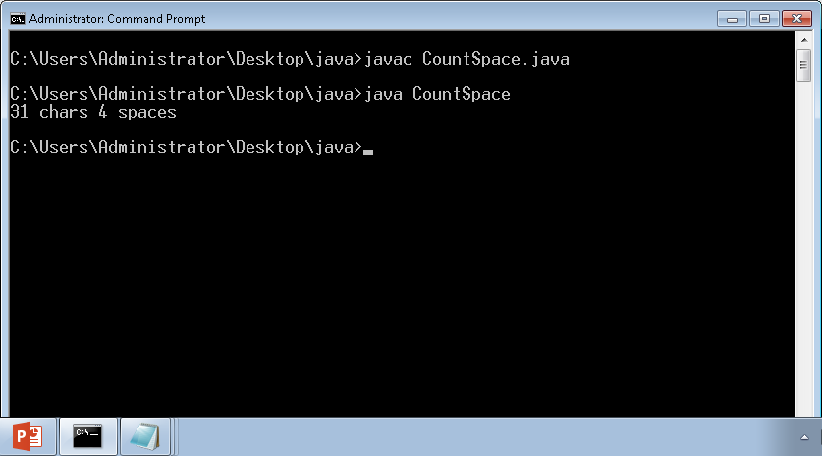

Slide 28
Writer Example
import java.io.*;
public class WriterExample {
public static void main(String[] args) {
try {
Writer w = new FileWriter("output.txt");
String content = "I love my country";
w.write(content);
w.close();
System.out.println("Done");
} catch (IOException e) {
e.printStackTrace();
}
}
}

Slide 29
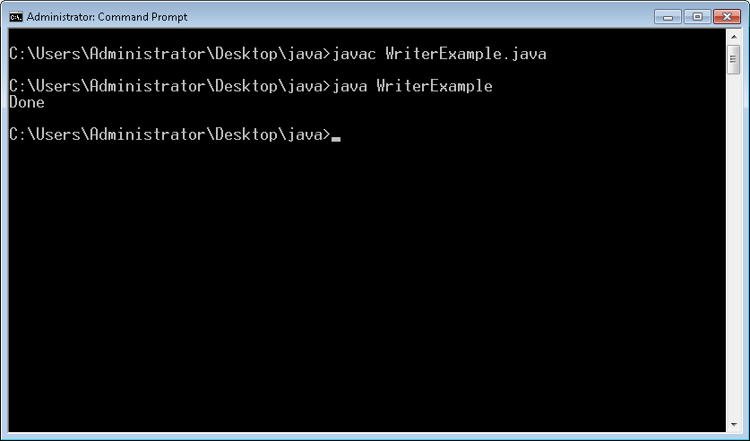

Slide 30
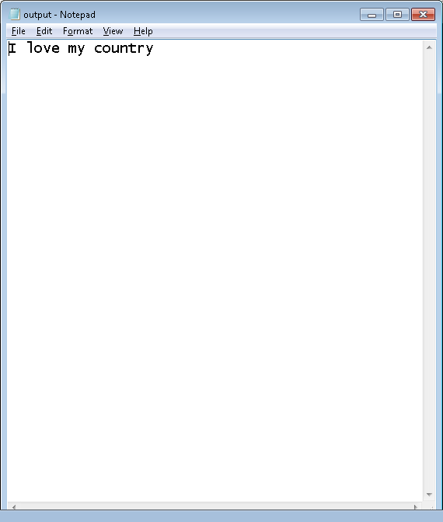

Slide 31
Writer Class Hierarchy
Writer
BufferedWriter
CharacterArrayWriter
FilterWriter
PrinterWriter
PipedWriter
OutputStreamWriter
StringWriter
FileWriter

Slide 32
Copying Characters from Files
Write a Program that copies contents of a source file to a destination file.
The names of source and destination files is passed as command line arguments.
Make sure that sufficient number of arguments are passed.
Print appropriate error messages.

Slide 33
FileCopy.java
import java.io.*;
public class FileCopy {
public static void main (String[] args)
{
if(args.length != 2)
{
System.out.println("Error: in sufficient arguments");
System.out.println("Usage - java FileCopy SourceFile DestFile");
System.exit(-1);
}
try {
FileReader srcFile = new FileReader(args[0]);
FileWriter destFile = new FileWriter(args[1]);
int ch;
while((ch=srcFile.read()) != -1)
destFile.write(ch);
srcFile.close();
destFile.close();
}
catch(IOException e)
{
System.out.println(e);
System.exit(-1);
} }
}

Slide 34
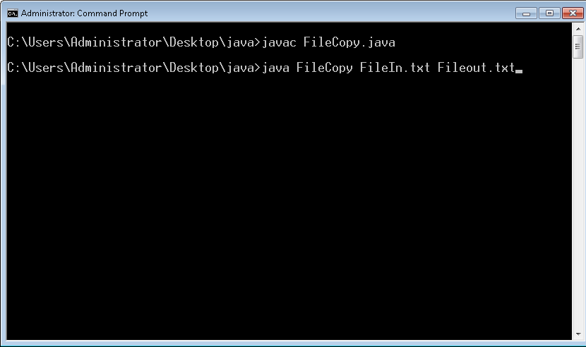

Slide 35
Runs and Outputs
Source file exists:
  java FileCopy FileIn.txt Fileout.txt
Source file does not exist:
  java FileCopy abc Fileout.txt
  java.io.FileNotFoundException: abc (No such file or directory)
In sufficient arguments passed
  java FileCopy FileIn.txt
  Error: in sufficient arguments
  Usage - java FileCopy SourceFile DestFile

Slide 36
Do the exercise
Write a program to print the all files and directory name as well as total count.
Hint: use File class methods
1. list()
2. isFile()
3. isDirectory()

Slide 37
CharArray reader/writer classes
The CharArrayWriter class can be used to write common data to multiple files. This class inherits Writer class. Its buffer automatically grows when data is written in this stream.
The CharArrayReader class is used to read character array as a reader (stream). It inherits Reader class.

Slide 38
CharArrayWriter
import java.io.CharArrayWriter;
import java.io.FileWriter;
public class CharArrayWriterExample {
public static void main(String args[])throws Exception{
CharArrayWriter out=new CharArrayWriter();
out.write("Welcome to java");
FileWriter f1=new FileWriter("D:\\a.txt");
FileWriter f2=new FileWriter("D:\\b.txt");
FileWriter f3=new FileWriter("D:\\c.txt");
FileWriter f4=new FileWriter("D:\\d.txt");
out.writeTo(f1);
out.writeTo(f2);
out.writeTo(f3);
out.writeTo(f4);
f1.close();
f2.close();
f3.close();
f4.close();
System.out.println("Success...");
}
}

Slide 39
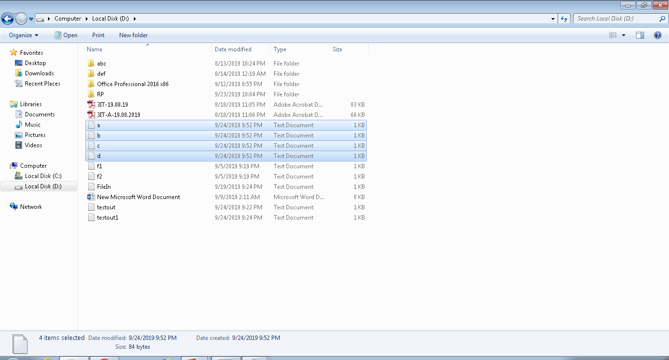

Slide 40
CharArrayReader
import java.io.CharArrayReader;
public class CharArrayExample{
public static void main(String[] ag) throws Exception {
char[] ary = { 'j', 'a', 'v', 'a', 'p', 'r', 'o', 'g', 'r', 'a','m' }; CharArrayReader reader = new CharArrayReader(ary);
int k = 0;
// Read until the end of a file
while ((k = reader.read()) != -1) {
char ch = (char) k;
System.out.print(ch + " : ");
System.out.println(k);
}
}
}

Slide 41
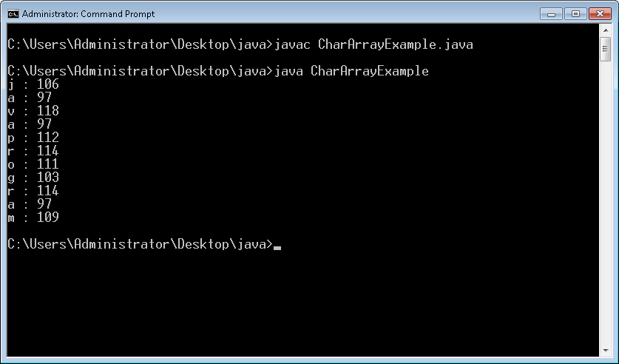

Slide 42
Buffered Streams
Java supports creation of buffers to store temporarily data that read from or written to a stream. This process is known as buffered I/O operation.
Buffered stream classes – BufferedInputStream, BufferedOutputStream, BufferedReader, BufferedWriter buffer data to avoid every read or write going to the stream.
These are used in file operations since accessing the disk for every character read is not efficient.

Slide 43
Buffered Streams
Buffered character streams understand lines of text.
BufferedWriter has a newLine method which writes a new line character to the stream.
BufferedReader has a readLine method to read a line of text as a String.

Slide 44
BufferedReader - example
Use a BufferedReader to read a file one line at a time and print the lines to standard output
import java.io.*;
class ReadTextFile {
public static void main(String[] args)
throws FileNotFoundException, IOException
{
BufferedReader in;
in = new BufferedReader( new FileReader(“Command.txt”));
String line;
while (( line = in.readLine()) != null )
{
System.out.println(line);
}
}
}

Slide 45
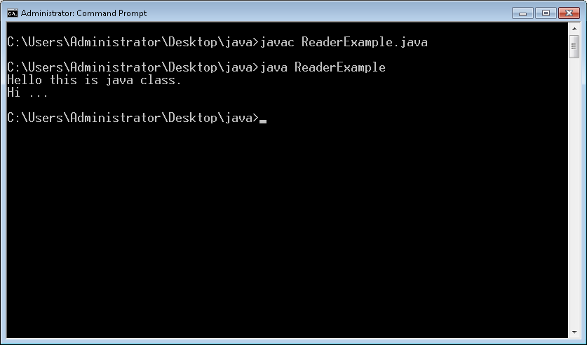

Slide 46
BufferedWriter - example
import java.io.*;
public class BufferedWriterExample {
public static void main(String[] args) throws Exception {
FileWriter writer = new FileWriter("D:\\testout1.txt");
BufferedWriter buffer = new BufferedWriter(writer);
buffer.write("Welcome to java.");
buffer.close();
System.out.println("Success");
}
}

Slide 47
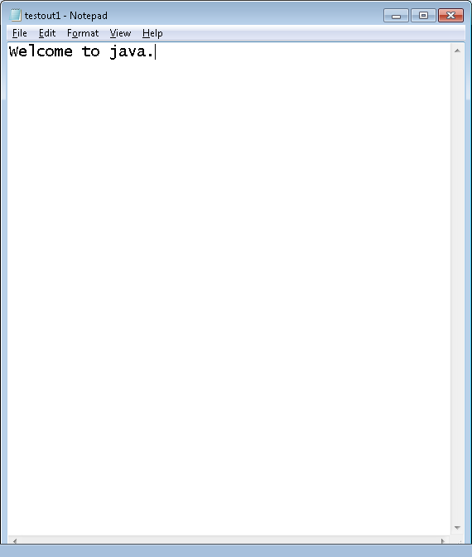

Slide 48
Reading/Writing Bytes
The FileReader and FileWriter classes are used to read and write 16-bit characters.
As most file systems use only 8-bit bytes, Java supports number of classes that can handle bytes. The two most commonly used classes for handling bytes are:
  FileInputStream (discussed earlier)
  FileOutputStream

Slide 49
Writing Bytes - Example
public class WriteBytes {
public static void main (String[] args)
{
byte cities[] = {'M', 'e', 'l', 'b', 'o', 'u', 'r', 'n', 'e', 'S', 'y','d', 'n', 'e', 'y'};
FileOutputStream outFile;
try{
outFile = new FileOutputStream("City.txt");
outFile.write(cities);
outFile.close();
}
catch(IOException e)
{
System.out.println(e);
System.exit(-1);
}
}}

Slide 50
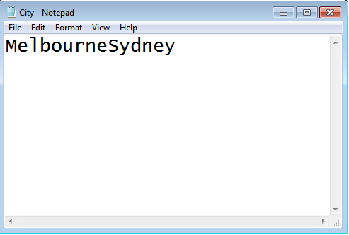
Output

Slide 51
Summary
All Java I/O classes are designed to operate with Exceptions.
User Exceptions and your own handler with files to manger runtime errors.
Subclasses FileReader / FileWriter support characters-based File I/O.
FileInputStream and FileOutputStream classes support bytes-based File I/O.
Buffered read operations support efficient I/O operations.

